Slide 1
New batch experiment with fixed testing set
Zheng Lu

Slide 2
Data can be roughly split into 3 disjoint sets
Total
Rosette: 78
Non-rosette: 211
Set 1: 0711 data
Rosette: 27
Non-rosette: 69
Set 2: 0715 data
Rosette: 20
Non-rosette: 62
Set 3: 0720 data
Rosette: 31
Non-rosette: 80

Slide 3
New dataset
We use 1 set as test, the other 2 sets as train. By using set1, set2, set3 as testing set separately, we created 3 datasets.
Dataset 1:
Set1 as test, set2 & set3 as train
Dataset 2:
Set2 as test, set1 & set3 as train
Dataset 3:
Set3 as test, set2 & set1 as train

Slide 4
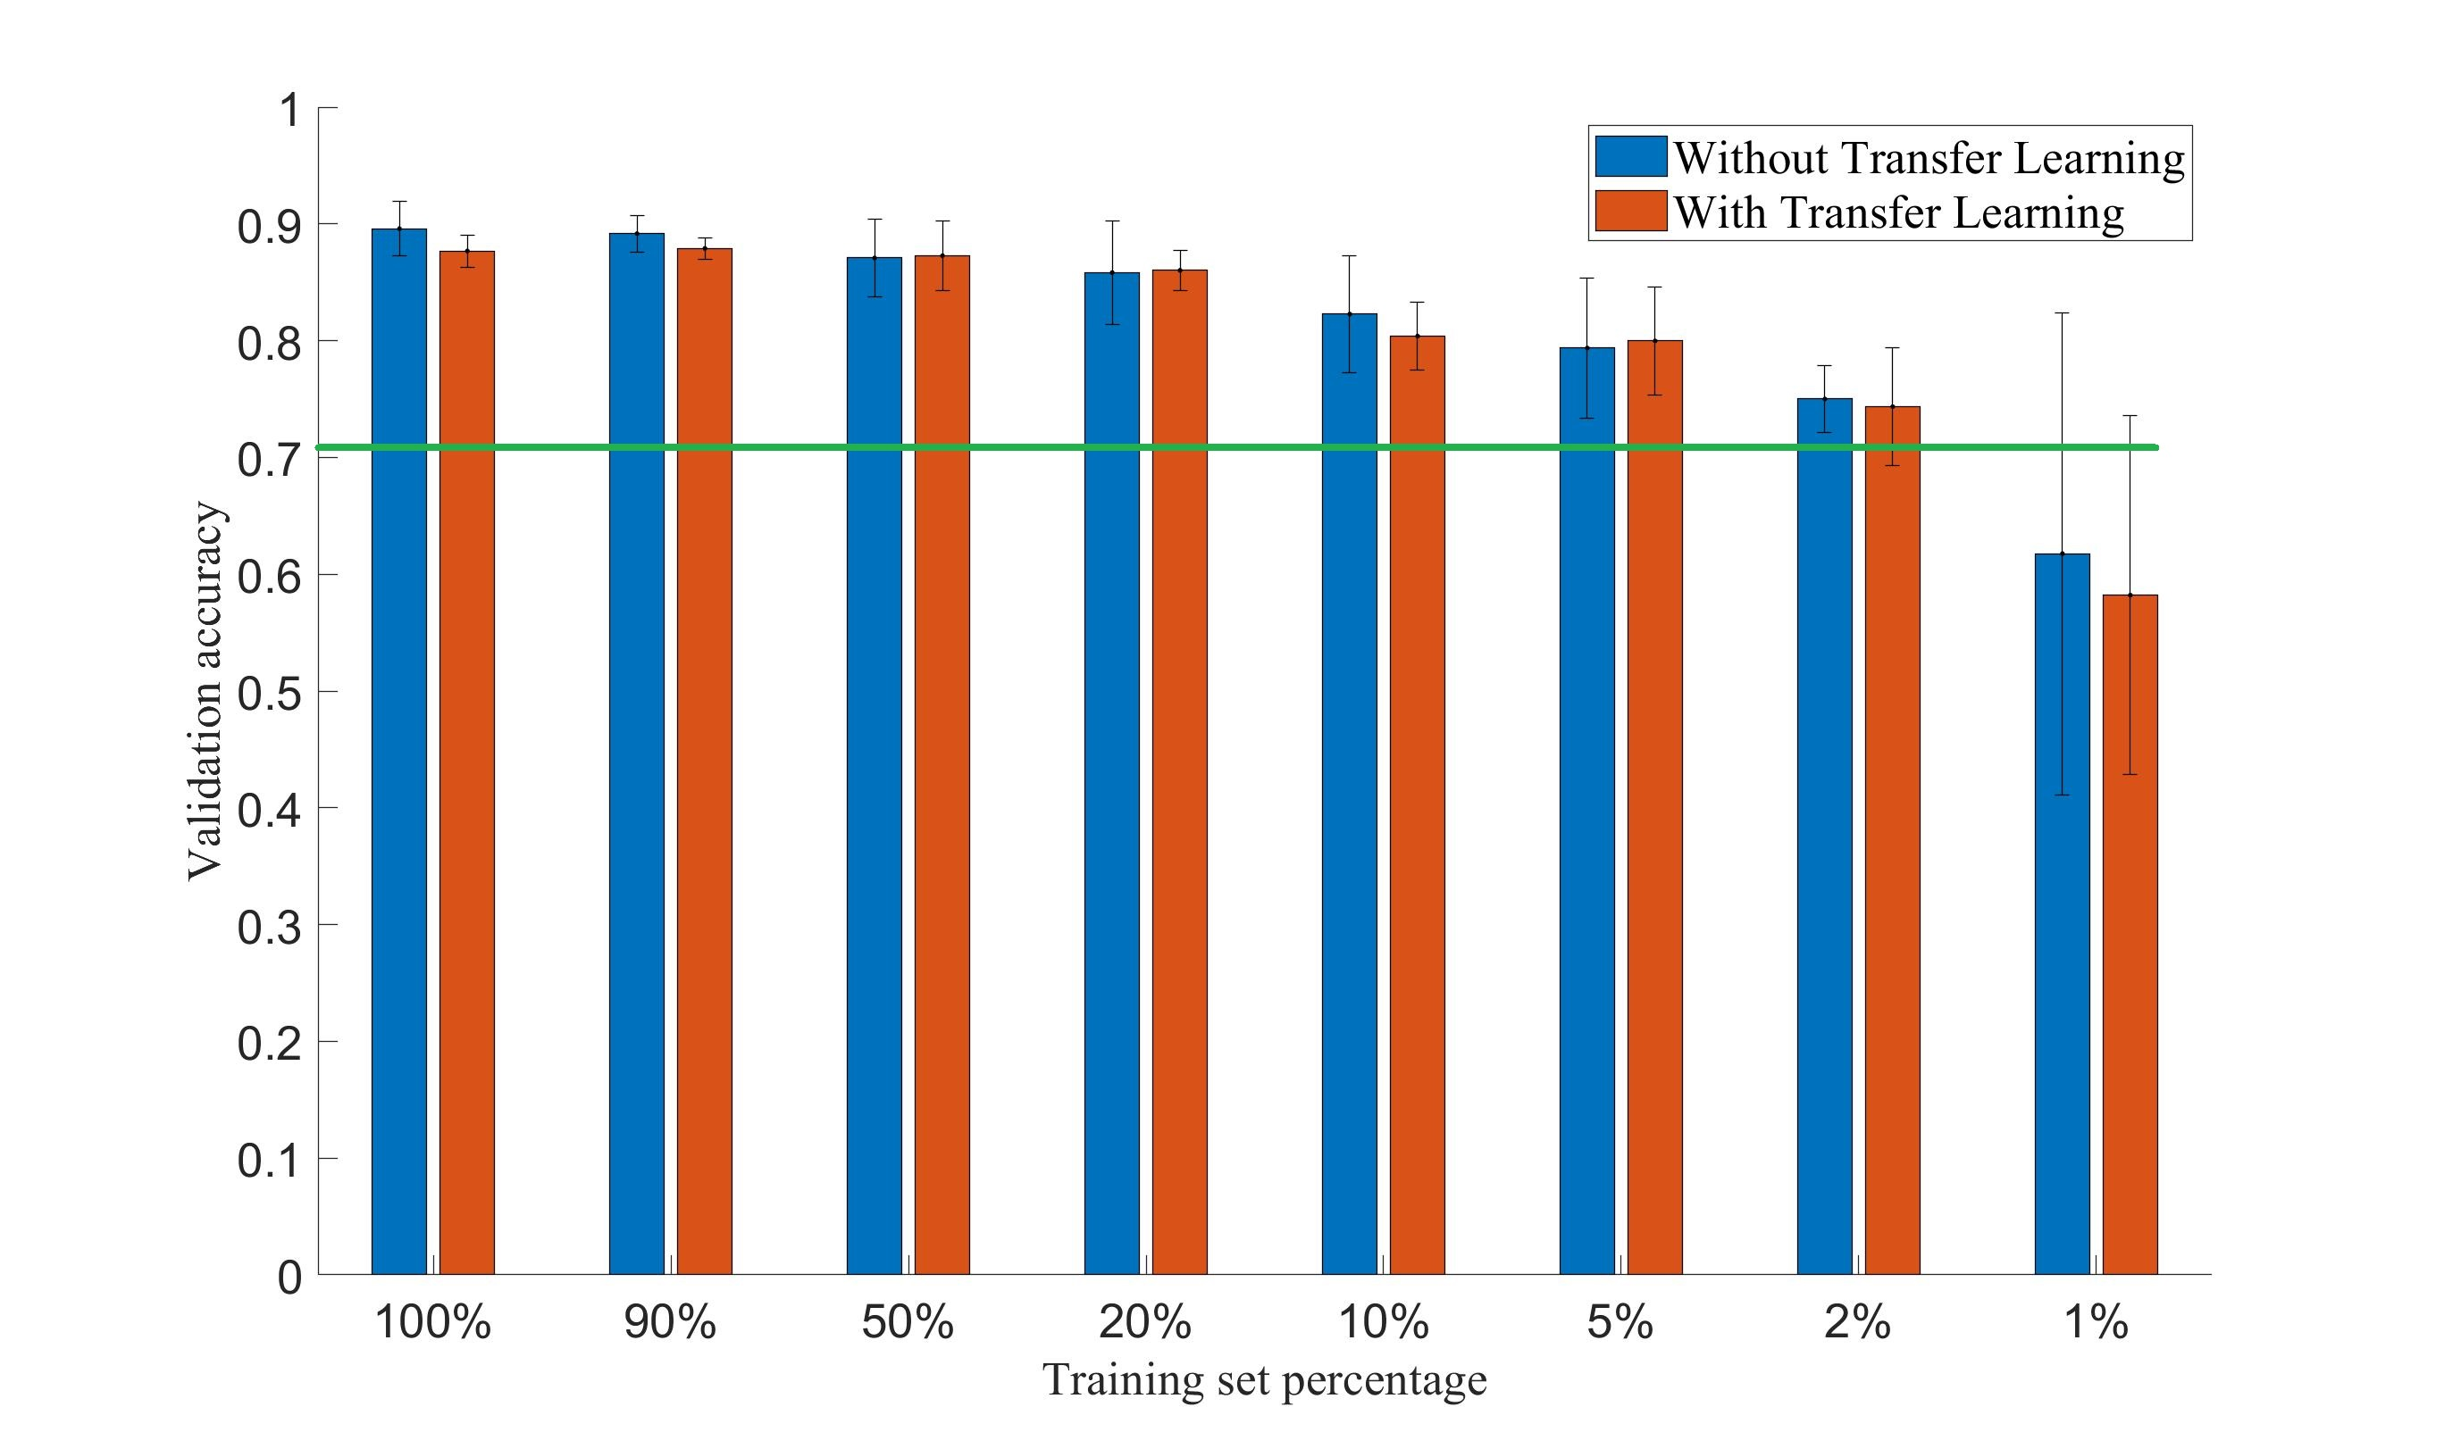
Result of dataset1
Note:
Green line is the accuracy when the network predict all testing sample as “non-rosette”

Slide 5
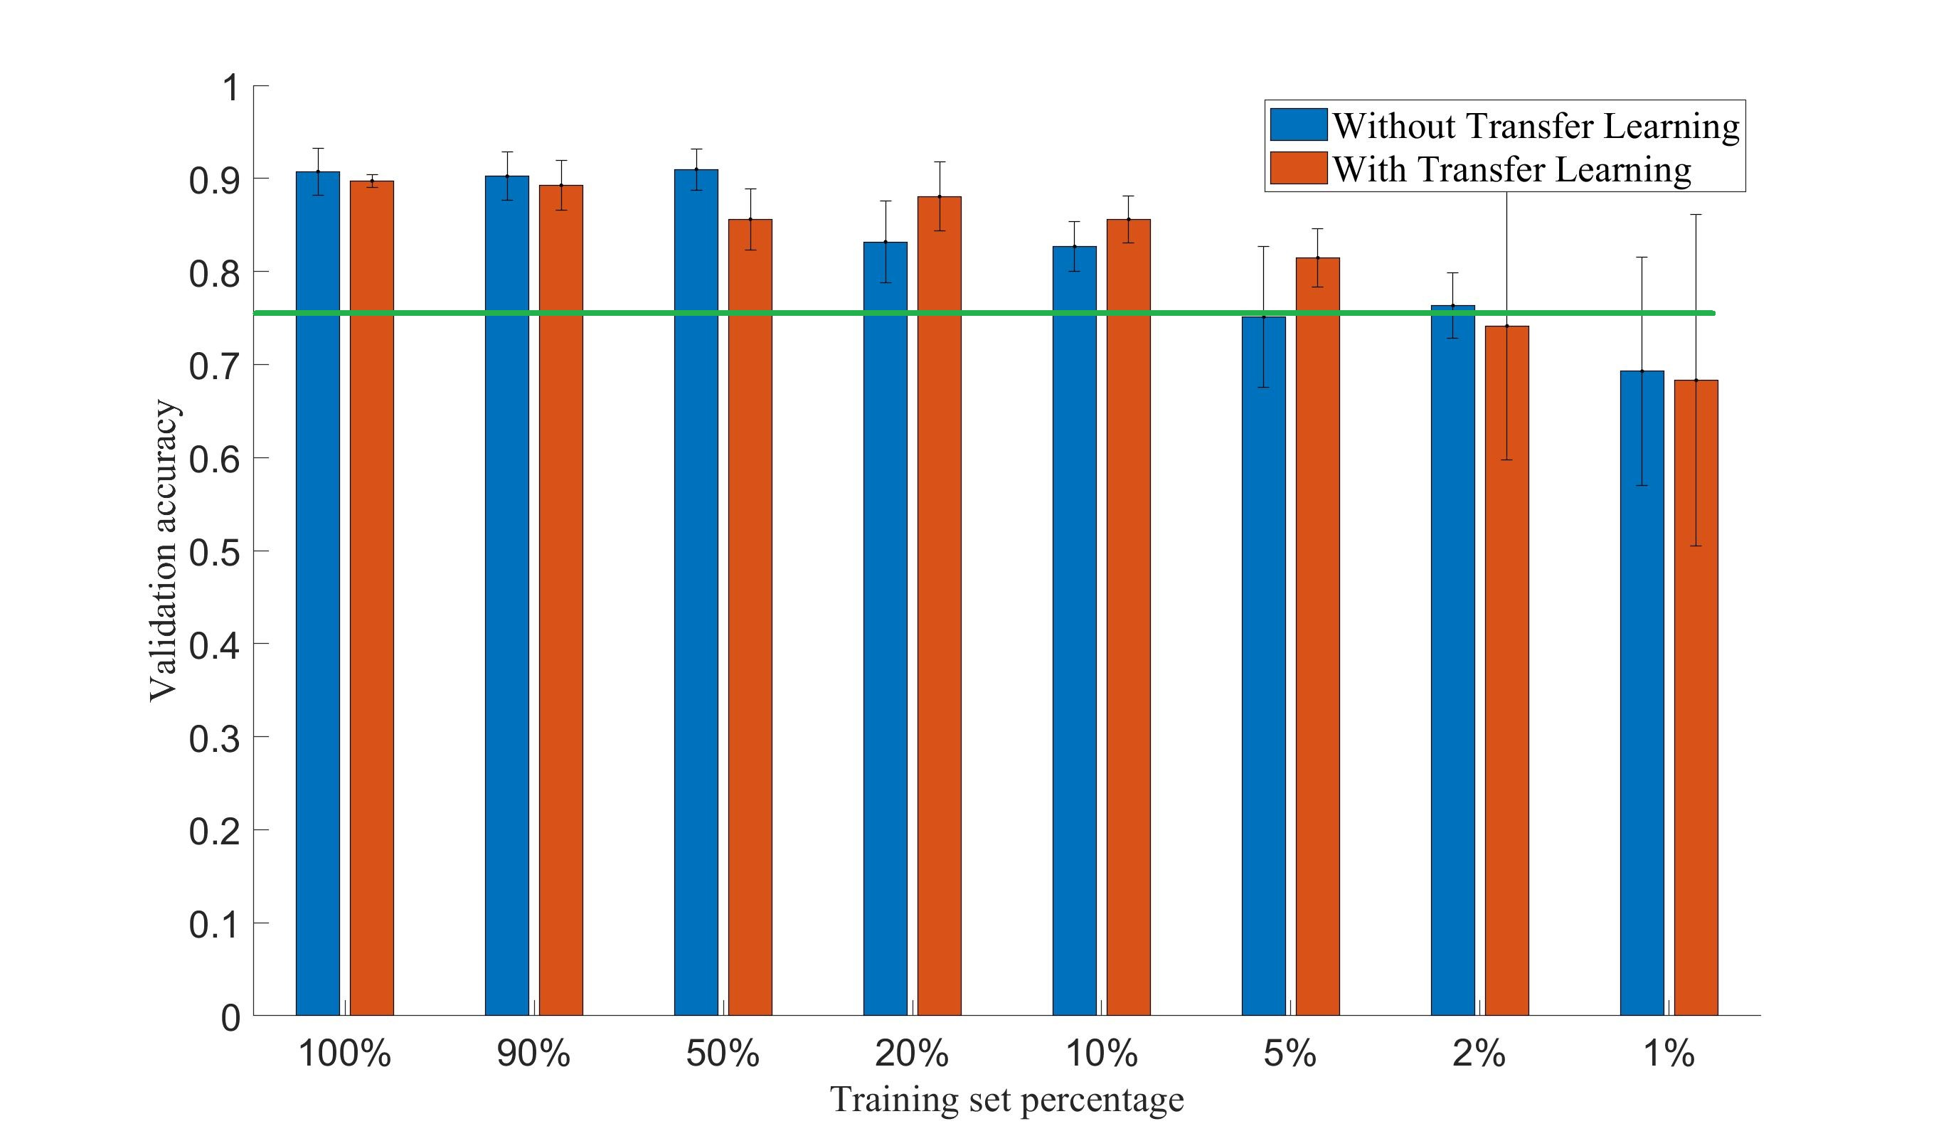
Result of dataset2
Note:
Green line is the accuracy when the network predict all testing sample as “non-rosette”

Slide 6
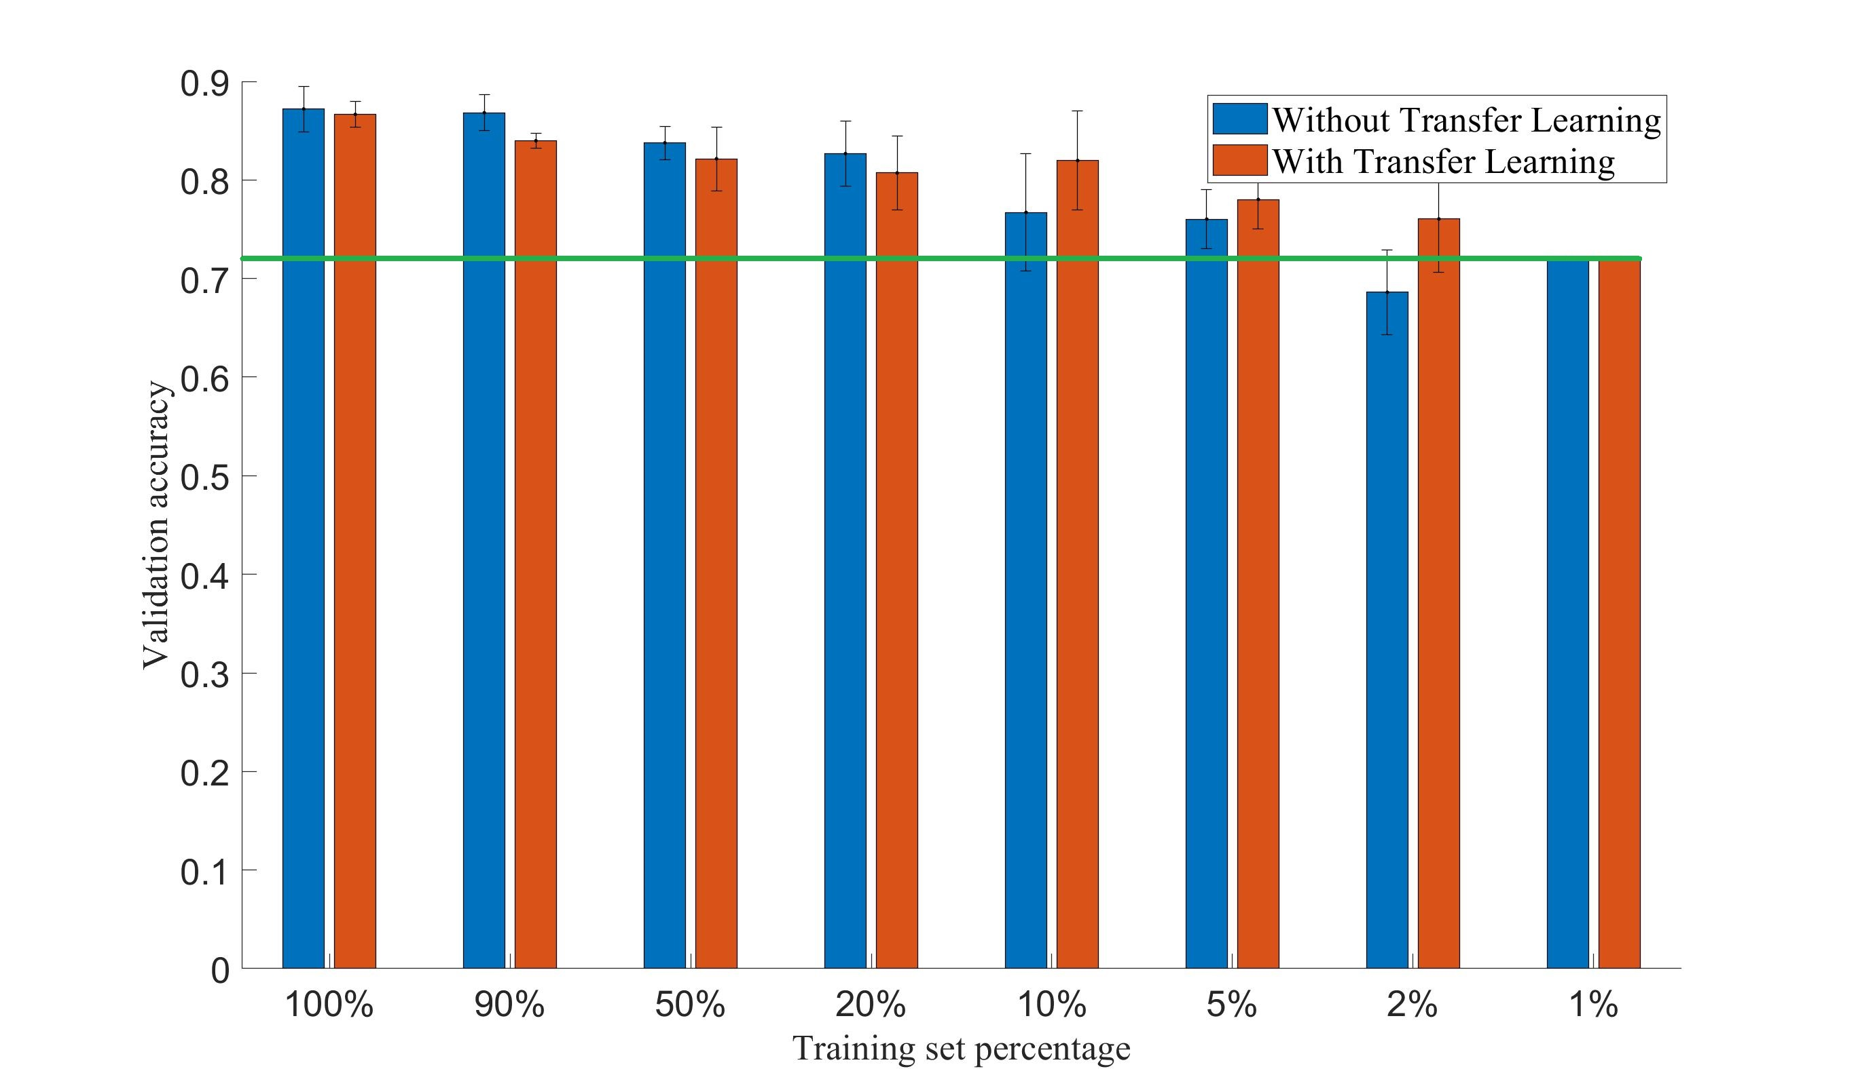
Result of dataset3
Note:
Green line is the accuracy when the network predict all testing sample as “non-rosette”
Note:
In dataset3, 1% training set only contains 1 non-rosette image and 0 rosette image.

